Slide 1


BVRIT HYDERABAD College of Engineering for Women Department of Information Technology
REAL-TIME INTRUSION DETECTION SYSTEM
USING MACHINE LEARNING ALGORITHM
Team- 16
M. Shivani (19WH1A1213)
B. Selvi Reddy (19WH1A1215)
Ch. Shravyasree (19WH1A1227)
J. Shreeya Reddy (19WH1A1234)
Under the Guidance of :
Name: Mr. K. Srikar Goud
Designation: Assistant Professor

Slide 2
CONTENTS
Introduction
Existing System
Problem statement
Literature Survey
Proposed system
Tools and Technologies
Feasibility Study
Societal impact
Architecture
Modules
UML Diagram
Implementation
Project Timeline
References

Slide 3
INTRODUCTION
Intrusion Detection is the first step to prevent security attack.
IDS detects attacks from a variety of systems and network sources by collecting information and then analyzes the information for possible security breaches.
As the number of smart devices which are connected to network continue to multiply widely, the more security issues are associated with it.

Slide 4
EXISTING SYSTEM
The early NIDS employed a simple structure. There was a limit to detecting various network attacks accurately.
The dataset used in most of the systems is KDD Cup 99.
It contains huge number of redundant records which causes learning algorithm to be biased towards the frequent records.

Slide 5
PROBLEM STATEMENT
In order to improve accuracy, decrease false alarms, and shorten training time for Intrusion Detection, it is necessary to discover an appropriate machine learning algorithm.
An Intrusion Detection System (IDS) is a device or software application that monitors a network or systems for malicious activity or policy violations.

Slide 6
LITERATURE SURVEY
S.No | Title of the paper | Author(s) | Description / Interpretation
1 | A Network Intrusion Detection Using Machine Learning Techniques. | Thomas Rincy, N., Roopam Gupta (2021). | The Datasets used are ‘KDD Cup99’ and ‘NSL-KDD’ datasets. They don’t contain data of present attacks such as Denial of Service.
2 | Optimizing Network Intrusion Detection Using Machine Learning. | Nayak, S., Patil, A.A.,RenganathaLakshmisudha (2021). | ML algorithms – support vector machine, artificial neural network.The Dataset Used is UNSW-NB15.
3 | A Review on Network Intrusion Detection System Using Machine Learning. | T. Rupa Devi, Srinivasu Badugu (2019). | The Dataset used is CIDDS-001. The Algorithm used is K-Nearest Neighbour.

Slide 7
PROPOSED SYSTEM
In this system we are trying to build an IDS algorithm based on supervised machine learning methods for developing such an efficient and flexible system that can detect intrusions from the data received in real time.
Finally, an Intrusion Detection system based on the Random Forest classifier is built using the optimal training dataset obtained by data sampling and the features selected by feature selection.

Slide 8
TOOLS AND TECHNOLOGIES
HARDWARE REQUIREMENTS
Processor – Intel Core i5
Memory (RAM)- 8GB
Storage-1 TB
SOFTWARE REQUIREMENTS
Google Colaboratory
Python
Wireshark
CIC Flowmeter
HPing5

Slide 9
FEASIBILITY STUDY
The System uses Random Forest Algorithm.
Tools required are Google Colab, Wireshark, CIC Flowmeter.
Dataset used is CICIDS2017.

Slide 10
SOCIETAL IMPACT
An Intrusion Detection System in cyber security protects all categories of data from theft and damage.
It analyses different attacks, identifies their patterns and helps the administrator to organize and implement effective control.
It provides additional layer of protection.

Slide 11
ARCHITECTURE
- - - - - - - - - - - - - - - - - - - - - - - - - - - - - - - - - - - - - - - - - - -
Training Phase
Training
Dataset
ML Algorithm
- - - - - - - - - - - - -
- - - - - - - - - - - - -
Original
Dataset
Data
Preprocessing
- - - - - - - - - - - - - - - - - - - - - - - - - - - - - - - - - - - - - - - - - - -
- - - - - - - - - - - - - - - - - - - - - - - - - - - - - - - - - - - - - - - - - - -
Testing Phase
Realtime
Dataset
Data
Preprocessing
Testing
Dataset
Trained
ML Model
- - - - - - - - - - - - -
- - - - - - - - - - - - -
- - - - - - - - - - - - - - - - - - - - - - - - - - - - - - - - - - - - - - - - - - -
Benign
Attack

Slide 12
MODULES
Generating Realtime Dataset with attacks
Training with CICIDS2017 Dataset
Data Preprocessing
Testing the Model with Realtime Dataset

Slide 13
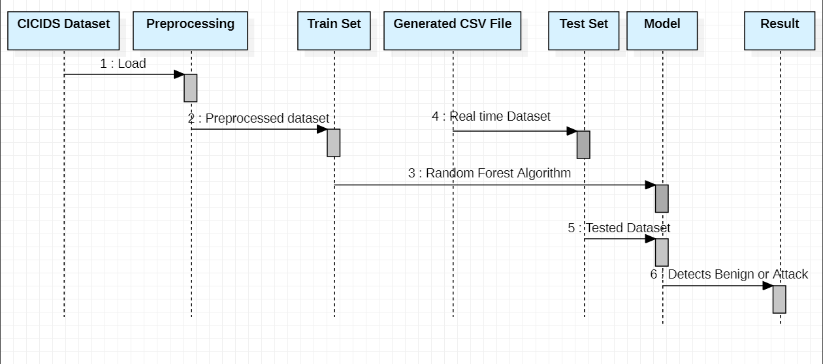
UML DIAGRAM
Sequence Diagram

Slide 14
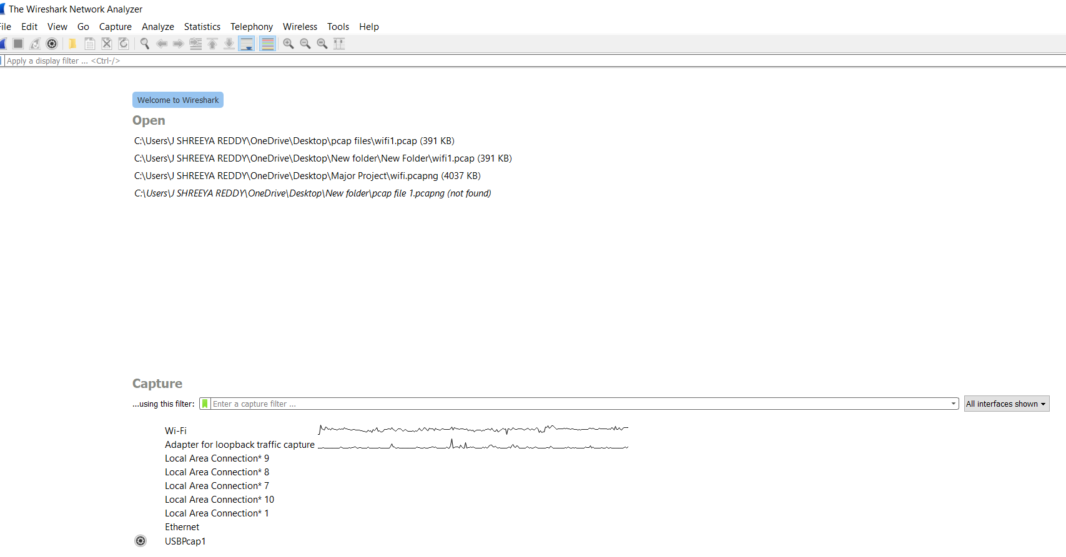
IMPLEMENTATION
Fig- 1:Wireshark tool

Slide 15
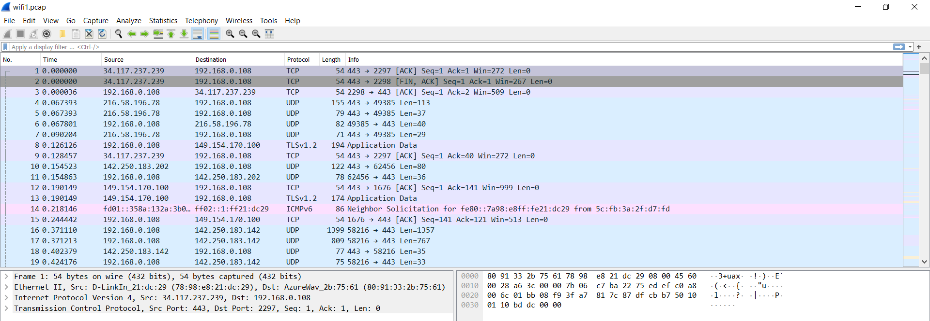
IMPLEMENTATION
Fig- 2:Pcap file from Wireshark tool

Slide 16
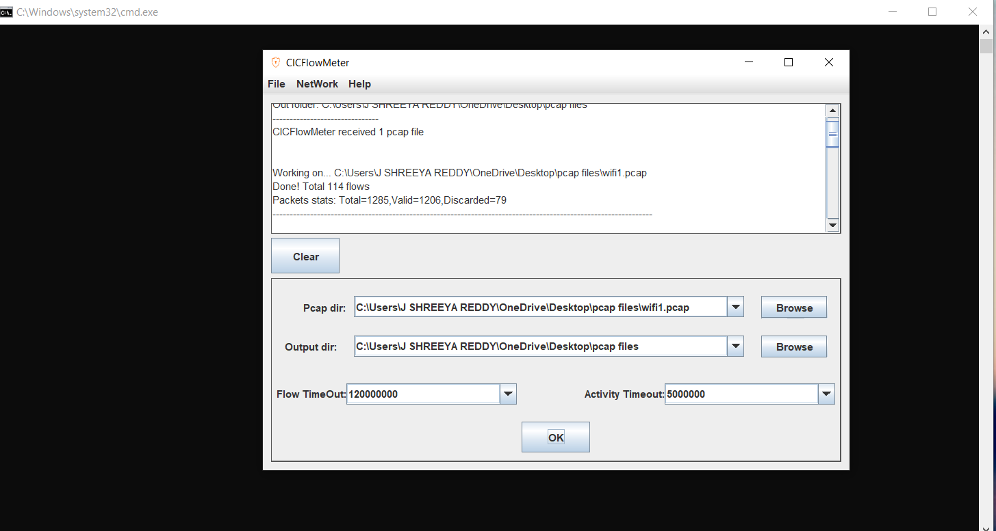
IMPLEMENTATION
Fig- 3:Generating csv file from CIC Flowmeter tool

Slide 17
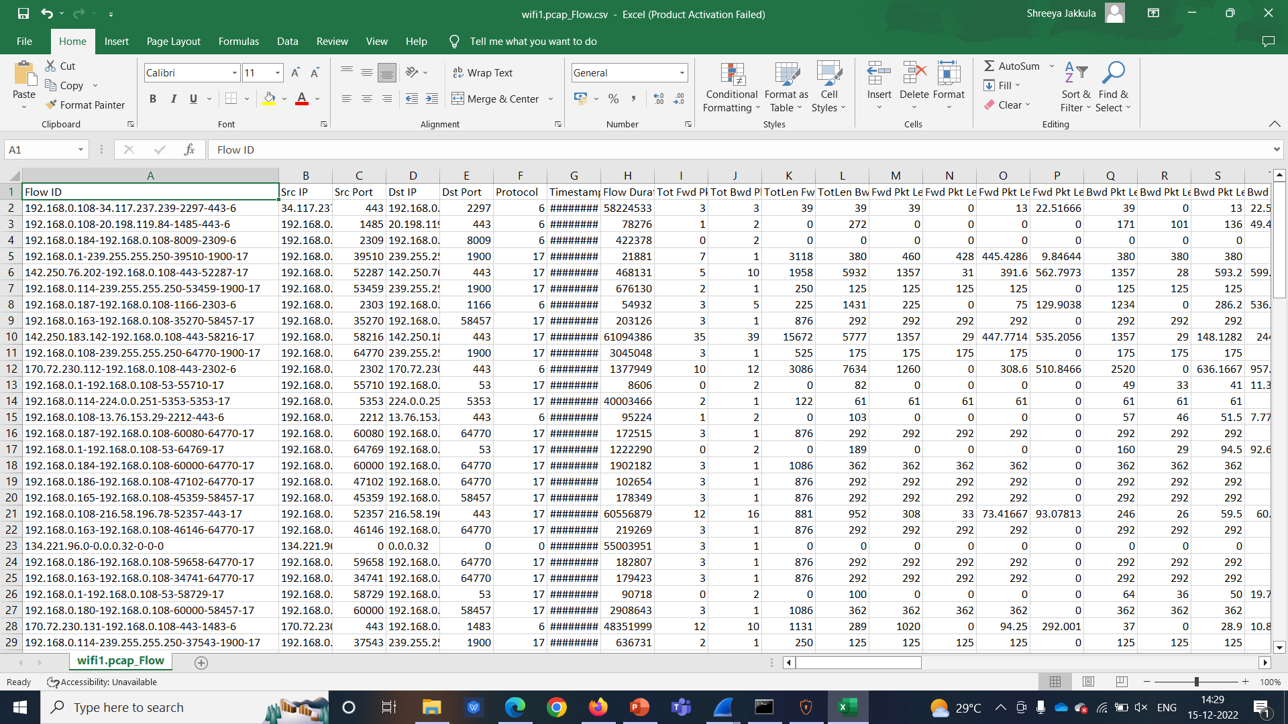
IMPLEMENTATION
Fig- 4:Generated csv file

Slide 18
CONCLUSION
CSV file generation is done.
Data Preprocessing, Testing ,Building model, Training will be doing in future.

Slide 19
PROJECT PLAN
Date( From – To) | Duration | Task
06.09.22 - 15.10.22 | 3 weeks | Domain Selection and Abstract Submission
16.10.22 - 06.11.22 | 3 weeks | Literature Survey
07.11.22 - 14.11.22 | 1 week | Requirement Analysis
15.11.22 - 22.12.22 | 5 weeks | Partial Implementation

Slide 20
REFERENCES
Nayak, S., Patil, A.A., Renganathan, R., Lakshmisudha, K. (2021). “Optimizing Network Intrusion Detection Using Machine Learning”. In: Stahlbock, R., Weiss, G.M., Abou-Nasr, M., Yang, CY., Arabnia, H.R., Deligiannidis, L. (eds) Advances in Data Science and Information Engineering.
Naveen Bindra, Manu Sood “Detecting DDoS Attacks Using Machine Learning Techniques and Contemporary Intrusion Detection Dataset”. Aut. Control Comp. Sci. 53, 419–428 (2019).
Dutt, I., Borah, S., Maitra, I.K., Bhowmik, K., Maity, A., Das, S. (2018). “Real-Time Hybrid Intrusion Detection System Using Machine Learning Techniques”. In: Bera, R., Sarkar, S., Chakraborty, S. (eds) Advances in Communication, Devices and Networking .

Slide 21
THANK YOU!!

